Slide 1
Agile: adaptive software development approach
CS250 - Software Development Life Cycle
Souther New Hampshire Univeristy
Chao Guan
2022-04-16
Professor Tammy Morrison

Slide 2
Overview of the Scrum-agile approach
Scrum-agile approach is an adaptive and flexible project mangement methdology that develops projects in an incremental and iterative manner, with its focus on product value and customer satisfaction.

Slide 3
Waterfall versus Agile Development
Waterfall | Agile
sequential, plan-driven | iterative, customer-centered,
limited customer interaction | customer engagement
fixed cost | non-fixed cost
changes are discouraged | changes are welcome

Slide 4
Various Roles on a Scrum-agile Team
Product Owner | Scrum Master | Team Members
Responsible for managing Product Backlog Collecting and defining user requirements Prioritizing the workload for the Scrum Team | Provide guidance to the Scrum Team to implement Scrum. Plan and execute various Scrum events. Perve the Scrum team to remove obstacles in the development process | Contribute in sprint planning and restropective review Utilize experise to design products customized to users’ requirements Test the projects to be deliverable

Slide 5
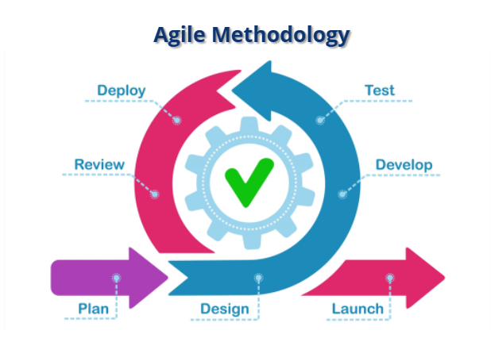
Phases of SDLC
Plan: the project owner defines user requirements, determine work priorities, and establish project roadmap.
Design: developers design the project based off the defined user requirements.
Develop: the cross-functional agile team develop the project into a concrete product and maintain on-going interaction with customers for feedback.
Test: testers test the project against the user requirements.
Deploy: projects are deployed to customer for production
Review: the customer reviews the efficiency of the product in its daily production.
Lunch: the customer launches the product for his business activities.
source: snhu-media

Slide 6
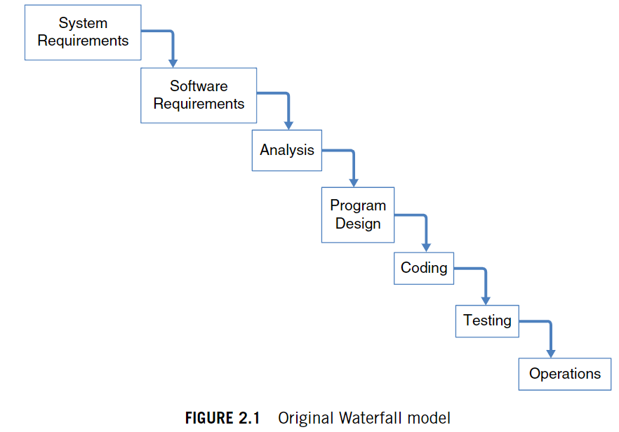
Differences in Waterfall Development Approach
The waterfall development approach is a sequential method in which each step depends on its previous one.
There is limited customer-developer interaction as the coding is based on the design of the previous phase.
If the testing is failed, the process has to start over.
Source: The Project Manager’s Guide to Mastering Agile

Slide 7
When to use a waterfall approach or an agile approach?
The level of Uncertainty in the project
With many uncertain factors, an agile approach works better than the waterfall
Budget restriction
The project by the agile approach tends to rely on non fixed budget. If there is a limited budget, the waterfall approach works better within the budget limit.

Slide 8
References
Cobb, C. G. (2015). The project manager’s guide to mastering agile : principles and practices for an adaptive approach. John Wiley
CS250-Module One: SDLC Methodologies. (n.d.). Snhu-Media.snhu.edu. Retrieved April 16, 2022, from http://snhu- media.snhu.edu/files/course_repository/undergraduate/cs/cs250/storyline/mod1/story_html5.html
Ihor. (2021, September 30). The Agile Software Development Life Cycle: All You Need to Know. DistantJob - Remote Recruitment Agency. https://distantjob.com/blog/agile-software-development-life-cycle/
Mangrulkar, A. (2018, September 26). Reviews in Software Development Life Cycle. Blog.e-Zest.com. https://blog.e-zest.com/reviews-in-software- development-life-cycle#:~:text=Review%20plays%20an%20important%20role

